Slide 1
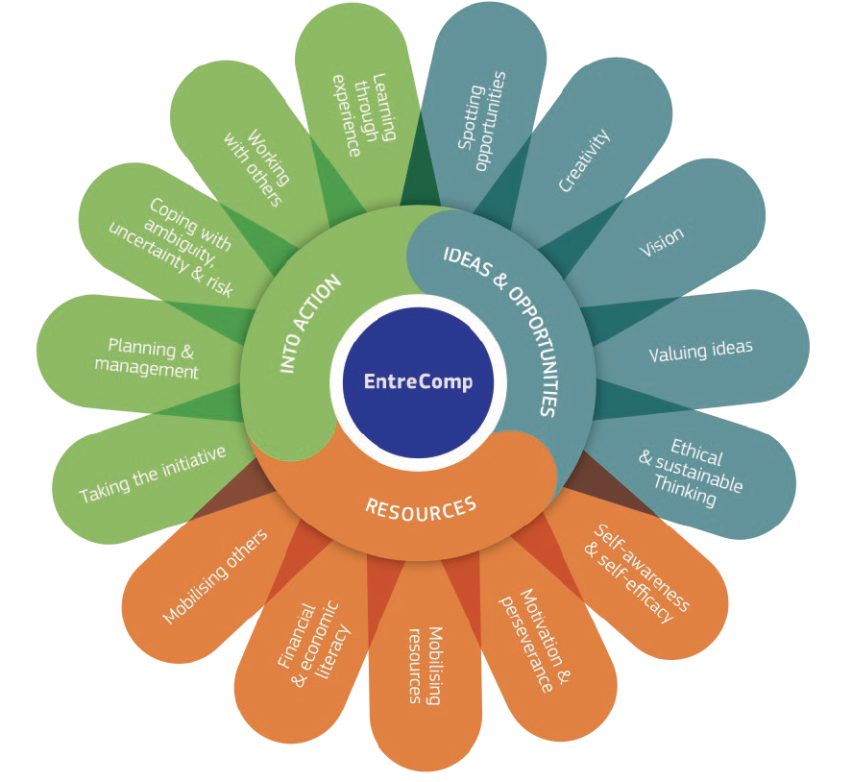
3.1 Taking the Initiative
3.1.A Initiate Processes that create values
This project has been funded with support from the European Commission. This document and its contents reflect the views only of the authors, and the Commission cannot be held responsible for any use which may be made of the information contained therein​
Legal description – Creative Commons licensing: The materials published on the EntreComp project website are classified as Open Educational Resources' (OER) and can be freely (without permission of their creators): downloaded, used, reused, copied, adapted, and shared by users, with information about the source of their origin.

Slide 2
Creating Value: where to start
The value of an organisation is represented by how innovative and sustainable is its underling Business Idea.
Business Ideas might come from two different considerations:
Valorising unexplored opportunities
Exploiting unmatched needs
The Business Idea represents the core values of your organisation.
This project has been funded with support from the European Commission. This document and its contents reflect the views only of the authors, and the Commission cannot be held responsible for any use which may be made of the information contained therein​
Legal description – Creative Commons licensing: The materials published on the EntreComp project website are classified as Open Educational Resources' (OER) and can be freely (without permission of their creators): downloaded, used, reused, copied, adapted, and shared by users, with information about the source of their origin.

Slide 3
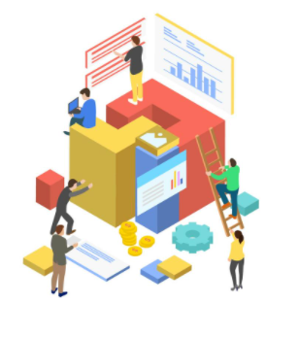
Creating Value: where to start
The main assets of a Business are represented by:
Platforms
Processes
People
Depending on how these elements are combined together, entrepreneurs shape their Business Model, i.e. the way in which an organisation creates and delivers social and economic value.
This project has been funded with support from the European Commission. This document and its contents reflect the views only of the authors, and the Commission cannot be held responsible for any use which may be made of the information contained therein​
Legal description – Creative Commons licensing: The materials published on the EntreComp project website are classified as Open Educational Resources' (OER) and can be freely (without permission of their creators): downloaded, used, reused, copied, adapted, and shared by users, with information about the source of their origin.

Slide 4
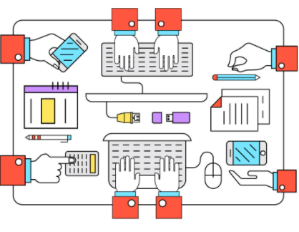
1. The Platform
The Business Platform refers to the operational contexts faced on a daily basis by entrepreneurs. The Platform hosts:
Competitors
Customers
Employees
Technologies
Market trends
Macroeconomy dynamics
Etc.
This project has been funded with support from the European Commission. This document and its contents reflect the views only of the authors, and the Commission cannot be held responsible for any use which may be made of the information contained therein​
Legal description – Creative Commons licensing: The materials published on the EntreComp project website are classified as Open Educational Resources' (OER) and can be freely (without permission of their creators): downloaded, used, reused, copied, adapted, and shared by users, with information about the source of their origin.

Slide 5
2. Processes
Regardless of their strategic Offer, every business puts is place processes and procedures to create values for their clients.
Raw materials and resources of any kind (inputs) are further refined through technologies, know-hows and experiences (process) to produce and finalise final products / services (output).
This project has been funded with support from the European Commission. This document and its contents reflect the views only of the authors, and the Commission cannot be held responsible for any use which may be made of the information contained therein​
Legal description – Creative Commons licensing: The materials published on the EntreComp project website are classified as Open Educational Resources' (OER) and can be freely (without permission of their creators): downloaded, used, reused, copied, adapted, and shared by users, with information about the source of their origin.

Slide 6
2. Processes – Value Chain Model
In the between of the Input-Output Cycle, resources pass through two distinct clusters of processes:
Primary – the ones that directly contribute to the “transformation” of Inputs into Outputs and the generation of profit (i.e. Sales)
Secondary – the ones that contribute to the efficiency and efficacy of the firsts (i.e. Technologies development and innovation)
This project has been funded with support from the European Commission. This document and its contents reflect the views only of the authors, and the Commission cannot be held responsible for any use which may be made of the information contained therein​
Legal description – Creative Commons licensing: The materials published on the EntreComp project website are classified as Open Educational Resources' (OER) and can be freely (without permission of their creators): downloaded, used, reused, copied, adapted, and shared by users, with information about the source of their origin.

Slide 7
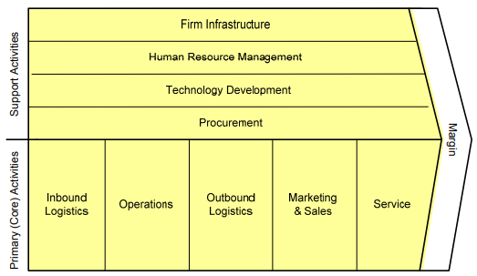
2. Processes – Value Chain Model
Source: Michael E. Porter, Competitive Advantage, 1985, p.87
This project has been funded with support from the European Commission. This document and its contents reflect the views only of the authors, and the Commission cannot be held responsible for any use which may be made of the information contained therein​
Legal description – Creative Commons licensing: The materials published on the EntreComp project website are classified as Open Educational Resources' (OER) and can be freely (without permission of their creators): downloaded, used, reused, copied, adapted, and shared by users, with information about the source of their origin.

Slide 8
3. People
People Management is one of the greatest and most challenging tasks faced by any entrepreneur.
People (i.e. the know-hows, the professional backgrounds, the technical experiences) represent the true driving force of an organisation.
This project has been funded with support from the European Commission. This document and its contents reflect the views only of the authors, and the Commission cannot be held responsible for any use which may be made of the information contained therein​
Legal description – Creative Commons licensing: The materials published on the EntreComp project website are classified as Open Educational Resources' (OER) and can be freely (without permission of their creators): downloaded, used, reused, copied, adapted, and shared by users, with information about the source of their origin.

Slide 9
Value Creation vs Value Outcomes
Value is a very complex concept that comes in many forms and shapes:
Qualitative Value
Quantitative Value
Output (the actual “result” in terms of product or service produced by the enterprise)
Outcome (the expected impact from that product/service not just as profit, i.e. customer satisfaction)
This project has been funded with support from the European Commission. This document and its contents reflect the views only of the authors, and the Commission cannot be held responsible for any use which may be made of the information contained therein​
Legal description – Creative Commons licensing: The materials published on the EntreComp project website are classified as Open Educational Resources' (OER) and can be freely (without permission of their creators): downloaded, used, reused, copied, adapted, and shared by users, with information about the source of their origin.

Slide 10
3.1 Taking the Initiative
3.1.B Take Up Challenges
This project has been funded with support from the European Commission. This document and its contents reflect the views only of the authors, and the Commission cannot be held responsible for any use which may be made of the information contained therein​
Legal description – Creative Commons licensing: The materials published on the EntreComp project website are classified as Open Educational Resources' (OER) and can be freely (without permission of their creators): downloaded, used, reused, copied, adapted, and shared by users, with information about the source of their origin.

Slide 11
What is a challenge
Entrepreneurship is per se an activity with an inherent and very high coefficient of risk.
The assumption of risk is among the few elements that distinct Entrepreneurs from Managers.
Such risk is related to the overall uncertainty upon the success and profitability of the entrepreneurial initiative.
This project has been funded with support from the European Commission. This document and its contents reflect the views only of the authors, and the Commission cannot be held responsible for any use which may be made of the information contained therein​
Legal description – Creative Commons licensing: The materials published on the EntreComp project website are classified as Open Educational Resources' (OER) and can be freely (without permission of their creators): downloaded, used, reused, copied, adapted, and shared by users, with information about the source of their origin.

Slide 12
What is a challenge
The entrepreneurial challenge consists in facing such uncertainty with courage, method and critical thinking so to mitigate the risk and meet the expected outcomes.
A strategic planning of available resources and consistent objectives will help the entrepreneur in overcoming daily and extraordinary difficulties.
This project has been funded with support from the European Commission. This document and its contents reflect the views only of the authors, and the Commission cannot be held responsible for any use which may be made of the information contained therein​
Legal description – Creative Commons licensing: The materials published on the EntreComp project website are classified as Open Educational Resources' (OER) and can be freely (without permission of their creators): downloaded, used, reused, copied, adapted, and shared by users, with information about the source of their origin.

Slide 13
What is a challenge
The entrepreneurial mindset sees in challenges great business opportunities waiting to be exploited and capitalised on.
In failure, entrepreneurs find learning outcomes that will help them to reshape their innovation path and re-set their competitive force.
As the famous Irish novelist Samuel Beckett once said:
Fail Harder, Fail better
This project has been funded with support from the European Commission. This document and its contents reflect the views only of the authors, and the Commission cannot be held responsible for any use which may be made of the information contained therein​
Legal description – Creative Commons licensing: The materials published on the EntreComp project website are classified as Open Educational Resources' (OER) and can be freely (without permission of their creators): downloaded, used, reused, copied, adapted, and shared by users, with information about the source of their origin.

Slide 14
What is a challenge
In business there is no way to avoid challenges: difficulties, risks and unexpected events are a part of the entrepreneurial journey as much as clients and competitors belongs to it.
Successful entrepreneurs stand out from the others thanks to the way they are able to manage the stress that comes with business management – so to re-shape it as a leading force for continuous improvement.
This project has been funded with support from the European Commission. This document and its contents reflect the views only of the authors, and the Commission cannot be held responsible for any use which may be made of the information contained therein​
Legal description – Creative Commons licensing: The materials published on the EntreComp project website are classified as Open Educational Resources' (OER) and can be freely (without permission of their creators): downloaded, used, reused, copied, adapted, and shared by users, with information about the source of their origin.

Slide 15
Avoid the traps
Challenges are just new and innovative solutions that are not known yet, but be careful and pay attention to the warning signs.
Make sure to set goals and objectives that are realistic for your reaching, consistently with the resources (technological, financial and experiential) that you can actually rely on.
In other words: aim for the starts, but watch out to not get burn.
This project has been funded with support from the European Commission. This document and its contents reflect the views only of the authors, and the Commission cannot be held responsible for any use which may be made of the information contained therein​
Legal description – Creative Commons licensing: The materials published on the EntreComp project website are classified as Open Educational Resources' (OER) and can be freely (without permission of their creators): downloaded, used, reused, copied, adapted, and shared by users, with information about the source of their origin.

Slide 16
3.1 Taking the Initiative
3.1.C Stick to intentions and carry out your plans
This project has been funded with support from the European Commission. This document and its contents reflect the views only of the authors, and the Commission cannot be held responsible for any use which may be made of the information contained therein​
Legal description – Creative Commons licensing: The materials published on the EntreComp project website are classified as Open Educational Resources' (OER) and can be freely (without permission of their creators): downloaded, used, reused, copied, adapted, and shared by users, with information about the source of their origin.

Slide 17
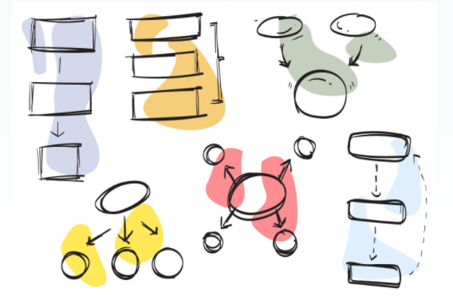
Seeking a definition of Plan
The mitigation of the entrepreneurial risk and the exploitation of business challenges is not something that happens by magic.
From the strategic planning of your entrepreneurial initiative depends the successful development of the same.
This project has been funded with support from the European Commission. This document and its contents reflect the views only of the authors, and the Commission cannot be held responsible for any use which may be made of the information contained therein​
Legal description – Creative Commons licensing: The materials published on the EntreComp project website are classified as Open Educational Resources' (OER) and can be freely (without permission of their creators): downloaded, used, reused, copied, adapted, and shared by users, with information about the source of their origin.

Slide 18
Seeking a definition of Plan
Strategic Planning is a very broad concept. It is possible to sum it up as the definition of the very basics of your business, such as:
Background and needs/opportunities assessment
Offer and covered markets
Targets and final beneficiaries
Competitors
Long-term Sustainability
Financial planning
Risk assessment
This project has been funded with support from the European Commission. This document and its contents reflect the views only of the authors, and the Commission cannot be held responsible for any use which may be made of the information contained therein​
Legal description – Creative Commons licensing: The materials published on the EntreComp project website are classified as Open Educational Resources' (OER) and can be freely (without permission of their creators): downloaded, used, reused, copied, adapted, and shared by users, with information about the source of their origin.

Slide 19
The Goal-oriented mindset
The successful achievement of results implies also a very important intangible resources deployed by the entrepreneurs: his/her mindset and his/her way of being.
A goal-driven person (i.e. the entrepreneur) is driven by the desire to set high standards for him/herself and works towards achieving them.
This project has been funded with support from the European Commission. This document and its contents reflect the views only of the authors, and the Commission cannot be held responsible for any use which may be made of the information contained therein​
Legal description – Creative Commons licensing: The materials published on the EntreComp project website are classified as Open Educational Resources' (OER) and can be freely (without permission of their creators): downloaded, used, reused, copied, adapted, and shared by users, with information about the source of their origin.

Slide 20
How to define your objectives
Keep it simple and define the priorities
Break down each goal in a set of sub-results
Be very specific and make them measurable
Do not push yourself to the limit: set objectives that are achievable
Scale up your learning curve and capitalise on others’ experience
Do not go alone: listen the feedbacks and bring back home valuable critiques
Celebrate the successes and pinpoint the lessons-learners
Evaluate your overall performance
This project has been funded with support from the European Commission. This document and its contents reflect the views only of the authors, and the Commission cannot be held responsible for any use which may be made of the information contained therein​
Legal description – Creative Commons licensing: The materials published on the EntreComp project website are classified as Open Educational Resources' (OER) and can be freely (without permission of their creators): downloaded, used, reused, copied, adapted, and shared by users, with information about the source of their origin.

Slide 21
Avoid the traps pt.2
The greatest threat that you might face is falling so much in love with your idea, to not realise when it is time to “let it go”.
Sometimes, when things do not work as expected, it might not about mere procedures and projects: maybe you are just not ready for that challenges yet (i.e. not enough resources, the idea is just not right, your offer does not match the market’s needs etc.).
This project has been funded with support from the European Commission. This document and its contents reflect the views only of the authors, and the Commission cannot be held responsible for any use which may be made of the information contained therein​
Legal description – Creative Commons licensing: The materials published on the EntreComp project website are classified as Open Educational Resources' (OER) and can be freely (without permission of their creators): downloaded, used, reused, copied, adapted, and shared by users, with information about the source of their origin.

Slide 22
Avoid the traps pt.2
Sticking to intentions is a conscious process that needs to be carried out with great sensitivity.
Otherwise it might unknowingly lead you to a tunnel-vision attitude that will prevent you to consider and analyse critical “warning” signs.
This project has been funded with support from the European Commission. This document and its contents reflect the views only of the authors, and the Commission cannot be held responsible for any use which may be made of the information contained therein​
Legal description – Creative Commons licensing: The materials published on the EntreComp project website are classified as Open Educational Resources' (OER) and can be freely (without permission of their creators): downloaded, used, reused, copied, adapted, and shared by users, with information about the source of their origin.

Slide 23
Evaluating the execution
Formative VS Summative:
Formative – step by step evaluation of processes and day-by-day development assessment of your activities.
Summative – upon conclusion of any major result, look back at what has been done and try to compare it against some standards / benchmarks (i.e. initial expectations). Are you satisfied with your achievements?
This project has been funded with support from the European Commission. This document and its contents reflect the views only of the authors, and the Commission cannot be held responsible for any use which may be made of the information contained therein​
Legal description – Creative Commons licensing: The materials published on the EntreComp project website are classified as Open Educational Resources' (OER) and can be freely (without permission of their creators): downloaded, used, reused, copied, adapted, and shared by users, with information about the source of their origin.

Slide 24
Evaluating the execution
When you feel like being a bit below the expectations, go back to the drawing boards and re-set your strategy starting from the experience acquired.
Be humble and involve third parties: external point of view represent always a precious source of knowledge for continuous, constant improvement.
This project has been funded with support from the European Commission. This document and its contents reflect the views only of the authors, and the Commission cannot be held responsible for any use which may be made of the information contained therein​
Legal description – Creative Commons licensing: The materials published on the EntreComp project website are classified as Open Educational Resources' (OER) and can be freely (without permission of their creators): downloaded, used, reused, copied, adapted, and shared by users, with information about the source of their origin.

Slide 25
Who are your allies?
Critiques come in many shapes; criticism from positive thinkers is for your own good and contribute to your direct empowerment.
Thorough the process, make sure to avoid hijackers: they speak from envy and there is not noble intention in their words.
Keep the positiveness close to you, nurture your spirit and stay healthy.
This project has been funded with support from the European Commission. This document and its contents reflect the views only of the authors, and the Commission cannot be held responsible for any use which may be made of the information contained therein​
Legal description – Creative Commons licensing: The materials published on the EntreComp project website are classified as Open Educational Resources' (OER) and can be freely (without permission of their creators): downloaded, used, reused, copied, adapted, and shared by users, with information about the source of their origin.

Slide 26
To recap: Checklist for self-check
Try to explain in your own words the concept of business Value
Could you list up to three characterizing elements of the business Platform?
What is the Difference between Primary and Secondary resources?
What is the difference between Output and Outcome?
Please, provide a definition of entrepreneurial challenge
What do we mean with “Strategic Planning”?
Please, list up to four strategies to define business objectives
What is the difference between Summative and Formative evaluation?
This project has been funded with support from the European Commission. This document and its contents reflect the views only of the authors, and the Commission cannot be held responsible for any use which may be made of the information contained therein​
Legal description – Creative Commons licensing: The materials published on the EntreComp project website are classified as Open Educational Resources' (OER) and can be freely (without permission of their creators): downloaded, used, reused, copied, adapted, and shared by users, with information about the source of their origin.

