Slide 1
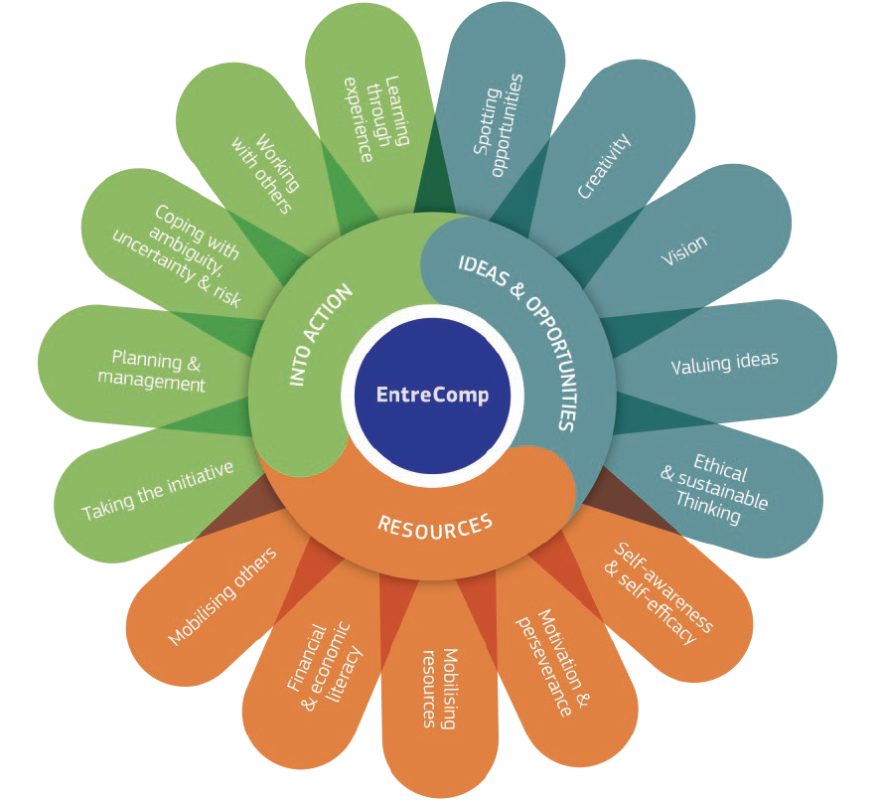
2.1 Self-awareness and self-efficacy
2.1.A Reflect on your aspirations and wants
This project has been funded with support from the European Commission. This document and its contents reflect the views only of the authors, and the Commission cannot be held responsible for any use which may be made of the information contained therein​
Legal description – Creative Commons licensing: The materials published on the EntreComp project website are classified as Open Educational Resources' (OER) and can be freely (without permission of their creators): downloaded, used, reused, copied, adapted, and shared by users, with information about the source of their origin.

Slide 2
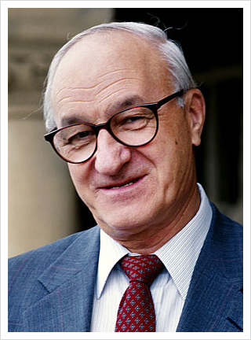
Self-efficacy: seeking a definition
Originally proposed by the Canadian psychologist Albert Bandura, the concept of self-efficacy refers to:
“how well one can execute courses of action required to deal with prospective situations”.
Source: Bandura, Albert (1982). "Self-efficacy mechanism in human agency". American Psychologist. 37 (2): 122–147
This project has been funded with support from the European Commission. This document and its contents reflect the views only of the authors, and the Commission cannot be held responsible for any use which may be made of the information contained therein​
Legal description – Creative Commons licensing: The materials published on the EntreComp project website are classified as Open Educational Resources' (OER) and can be freely (without permission of their creators): downloaded, used, reused, copied, adapted, and shared by users, with information about the source of their origin.

Slide 3
More in general…
Self-efficacy influences human behaviour in any aspect of social life (work, sentimental relationship, etc.).
By representing the overall system of beliefs a person holds as a mean to stimulate changes in its life, the perception of someone’s own self-efficacy will most likely be the most impactful variable to affect its choices and the challenges she/he is ready to face.
This project has been funded with support from the European Commission. This document and its contents reflect the views only of the authors, and the Commission cannot be held responsible for any use which may be made of the information contained therein​
Legal description – Creative Commons licensing: The materials published on the EntreComp project website are classified as Open Educational Resources' (OER) and can be freely (without permission of their creators): downloaded, used, reused, copied, adapted, and shared by users, with information about the source of their origin.

Slide 4
Implications for entrepreneurs
Self-efficacy is highly relevant for established entrepreneurs (and especially for aspiring ones) because it nurtures their capacity to be effective and impactful within their operational/business environments.
A healthy self-efficacy mindset brings a boost-effect to entrepreneur’s competence to act with confidence, effectiveness and motivation.
This project has been funded with support from the European Commission. This document and its contents reflect the views only of the authors, and the Commission cannot be held responsible for any use which may be made of the information contained therein​
Legal description – Creative Commons licensing: The materials published on the EntreComp project website are classified as Open Educational Resources' (OER) and can be freely (without permission of their creators): downloaded, used, reused, copied, adapted, and shared by users, with information about the source of their origin.

Slide 5
Self-awareness: seeking a definition
The roots of self-awareness goes back to Greek philosophy; the concept has become later (and still is) a major topic of interest among the community of psychologists and neuroscientists.
A major theory on the field states that self-awareness is a state of mind that enables people to compare and assess their current standards with their internals (and personal) expectations.
Source: “A theory of objective self-awareness”, 1972, S. Duval & R. Wick Lund
This project has been funded with support from the European Commission. This document and its contents reflect the views only of the authors, and the Commission cannot be held responsible for any use which may be made of the information contained therein​
Legal description – Creative Commons licensing: The materials published on the EntreComp project website are classified as Open Educational Resources' (OER) and can be freely (without permission of their creators): downloaded, used, reused, copied, adapted, and shared by users, with information about the source of their origin.

Slide 6
More in general…
Being self-awareness such a powerful mean to profoundly understand one’s emotions, strength and weaknesses, the Bandura’s theory on self-efficacy is actually one (among the many) direct implications of this concept.
Self-awareness triggers the design and “engineering” of a consistent response to a state of need – regardless of the context from where it comes from (family, business, etc.).
This project has been funded with support from the European Commission. This document and its contents reflect the views only of the authors, and the Commission cannot be held responsible for any use which may be made of the information contained therein​
Legal description – Creative Commons licensing: The materials published on the EntreComp project website are classified as Open Educational Resources' (OER) and can be freely (without permission of their creators): downloaded, used, reused, copied, adapted, and shared by users, with information about the source of their origin.

Slide 7
Implications for entrepreneurs
Self-aware entrepreneurs conduct themselves with reliability, leadership and emotional intelligence.
They allow, for them and the others, the most ethical, sustainable and innovative working environment; leveraging on a deep understanding of their moral duties, each one’s capabilities and intimate identities.
This project has been funded with support from the European Commission. This document and its contents reflect the views only of the authors, and the Commission cannot be held responsible for any use which may be made of the information contained therein​
Legal description – Creative Commons licensing: The materials published on the EntreComp project website are classified as Open Educational Resources' (OER) and can be freely (without permission of their creators): downloaded, used, reused, copied, adapted, and shared by users, with information about the source of their origin.

Slide 8
The combination of the two…
…puts entrepreneurs in the position to understand and gain awareness of their role as commanders in chiefs and to act accordingly with effectiveness, efficacy and ethic. Self-efficacy and self-awareness are two major driving forces to clearly identify your needs and aspirations; plan structured paths to achieve them and nurture your motivations throughout the process.
This project has been funded with support from the European Commission. This document and its contents reflect the views only of the authors, and the Commission cannot be held responsible for any use which may be made of the information contained therein​
Legal description – Creative Commons licensing: The materials published on the EntreComp project website are classified as Open Educational Resources' (OER) and can be freely (without permission of their creators): downloaded, used, reused, copied, adapted, and shared by users, with information about the source of their origin.

Slide 9
2.1 Self-awareness and self-efficacy
2.1.B Identify your strengths and weaknesses
This project has been funded with support from the European Commission. This document and its contents reflect the views only of the authors, and the Commission cannot be held responsible for any use which may be made of the information contained therein​
Legal description – Creative Commons licensing: The materials published on the EntreComp project website are classified as Open Educational Resources' (OER) and can be freely (without permission of their creators): downloaded, used, reused, copied, adapted, and shared by users, with information about the source of their origin.

Slide 10
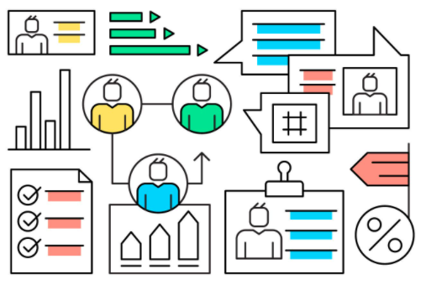
The strengths/weaknesses analysis
In career and professional development, such analysis is greatly exploited by Human Resources specialists to get a sense of the personal areas in which someone could improve/unleash its full potential.
S/W analysis are not to be confused with Personality Tests: they can complement each others while remaining two different tools with two different scopes.
This project has been funded with support from the European Commission. This document and its contents reflect the views only of the authors, and the Commission cannot be held responsible for any use which may be made of the information contained therein​
Legal description – Creative Commons licensing: The materials published on the EntreComp project website are classified as Open Educational Resources' (OER) and can be freely (without permission of their creators): downloaded, used, reused, copied, adapted, and shared by users, with information about the source of their origin.

Slide 11
A personal SWOT analysis
There is not such thing as an “handbook” for self-assessments. But one of the most recurrent instrument is the so called personal SWOT (Strengths; Weakness; Opportunities; Threats) analysis.
While this tool is highly exploited to evaluate the competitiveness of a business, some suggests its possible “re-cycling” even upon the individual and personal dimension.
This project has been funded with support from the European Commission. This document and its contents reflect the views only of the authors, and the Commission cannot be held responsible for any use which may be made of the information contained therein​
Legal description – Creative Commons licensing: The materials published on the EntreComp project website are classified as Open Educational Resources' (OER) and can be freely (without permission of their creators): downloaded, used, reused, copied, adapted, and shared by users, with information about the source of their origin.

Slide 12
Breaking down the four variables
Strengths: what can you do at your best…
Weaknesses: what you lack in…
Opportunities: what drives you and what triggers your top-notch mind states…
Threats: what scares you and what prevents you to act…
This project has been funded with support from the European Commission. This document and its contents reflect the views only of the authors, and the Commission cannot be held responsible for any use which may be made of the information contained therein​
Legal description – Creative Commons licensing: The materials published on the EntreComp project website are classified as Open Educational Resources' (OER) and can be freely (without permission of their creators): downloaded, used, reused, copied, adapted, and shared by users, with information about the source of their origin.

Slide 13
Connecting the dots…
From the simultaneous consideration of the four, here you have a full matrix that pinpoints the essentials of your attitudes, behaviours and values.
In doing so, it will be much easier for you to understand how to capitalize on your strengths so to contain your fears, and to enable for yourself the most favourable conditions for your efficiency and efficacy.
This project has been funded with support from the European Commission. This document and its contents reflect the views only of the authors, and the Commission cannot be held responsible for any use which may be made of the information contained therein​
Legal description – Creative Commons licensing: The materials published on the EntreComp project website are classified as Open Educational Resources' (OER) and can be freely (without permission of their creators): downloaded, used, reused, copied, adapted, and shared by users, with information about the source of their origin.

Slide 14
The group SWOT analysis
As a step further, the same process can be applied to a broader scale rather than the individual.
This will identify the dynamics that affect/impact/empower the team as a whole.
This project has been funded with support from the European Commission. This document and its contents reflect the views only of the authors, and the Commission cannot be held responsible for any use which may be made of the information contained therein​
Legal description – Creative Commons licensing: The materials published on the EntreComp project website are classified as Open Educational Resources' (OER) and can be freely (without permission of their creators): downloaded, used, reused, copied, adapted, and shared by users, with information about the source of their origin.

Slide 15
To recap: Checklist for self-check
On the basis of the previous content, please feel free to exercise and practice with the SWOT Model. Try to outline strengths and weaknesses of your own persona and identify those contextual factors that triggers or inhibits your greatest potentials…
Strengths | Weaknesses
… | …
Opportunities | Threats
… | …
This project has been funded with support from the European Commission. This document and its contents reflect the views only of the authors, and the Commission cannot be held responsible for any use which may be made of the information contained therein​
Legal description – Creative Commons licensing: The materials published on the EntreComp project website are classified as Open Educational Resources' (OER) and can be freely (without permission of their creators): downloaded, used, reused, copied, adapted, and shared by users, with information about the source of their origin.

Slide 16
2.1 Self-awareness and self-efficacy
2.1.C Influence the courses of the events
This project has been funded with support from the European Commission. This document and its contents reflect the views only of the authors, and the Commission cannot be held responsible for any use which may be made of the information contained therein​
Legal description – Creative Commons licensing: The materials published on the EntreComp project website are classified as Open Educational Resources' (OER) and can be freely (without permission of their creators): downloaded, used, reused, copied, adapted, and shared by users, with information about the source of their origin.

Slide 17
Sorting things out…
What just said about self-awareness, self-efficacy and SWOT, find concrete resolution in the ways you might be able to generate a positive impacts on events and peoples.
Keep always an eye on what is happening around you, test a plan B, and get ready for the worst to happen.
This project has been funded with support from the European Commission. This document and its contents reflect the views only of the authors, and the Commission cannot be held responsible for any use which may be made of the information contained therein​
Legal description – Creative Commons licensing: The materials published on the EntreComp project website are classified as Open Educational Resources' (OER) and can be freely (without permission of their creators): downloaded, used, reused, copied, adapted, and shared by users, with information about the source of their origin.

Slide 18
A brief recap
The assessment and evaluation of your S/W brings to the light major (dis)functionalities of your action;
These considerations will gain you great proficiency on a multilevel of social skills…
…that in turn will help you to be much more efficient and effective as an entrepreneur and leader.
This project has been funded with support from the European Commission. This document and its contents reflect the views only of the authors, and the Commission cannot be held responsible for any use which may be made of the information contained therein​
Legal description – Creative Commons licensing: The materials published on the EntreComp project website are classified as Open Educational Resources' (OER) and can be freely (without permission of their creators): downloaded, used, reused, copied, adapted, and shared by users, with information about the source of their origin.

Slide 19
Watch your steps…
Do not let your guard down: if things are going as expected, it does not imply that it will always be like that.
Setbacks are around the corner and you might not be able to see them coming; evaluate the uncertainty coming from your operational context and never take anything for granted.
Watch out for the alerting signals and get ready to deploy your counter measures.
This project has been funded with support from the European Commission. This document and its contents reflect the views only of the authors, and the Commission cannot be held responsible for any use which may be made of the information contained therein​
Legal description – Creative Commons licensing: The materials published on the EntreComp project website are classified as Open Educational Resources' (OER) and can be freely (without permission of their creators): downloaded, used, reused, copied, adapted, and shared by users, with information about the source of their origin.

Slide 20
Watch you steps…
Do not fear to be too inadequate:
Do your researches
Study
Pay attention
Listen and learn from who made it
Take valuable lessons
Honour your faults and responsibilities
Remain humble
This project has been funded with support from the European Commission. This document and its contents reflect the views only of the authors, and the Commission cannot be held responsible for any use which may be made of the information contained therein​
Legal description – Creative Commons licensing: The materials published on the EntreComp project website are classified as Open Educational Resources' (OER) and can be freely (without permission of their creators): downloaded, used, reused, copied, adapted, and shared by users, with information about the source of their origin.

Slide 21
…and what if nothing works?
It is a concrete possibility that, despite all of your efforts, you still cannot make an impact. In these cases, go back to the drawing board try to answer yourself few question:
Have I overestimated my strengths? If so, what did I miss?
Have I underestimated my weaknesses? If so, what did I miss?
Am I enough self-aware of the contexts surrounding me?
Am I enough self-efficient in what I do? Is there a way I can push myself forward?
This project has been funded with support from the European Commission. This document and its contents reflect the views only of the authors, and the Commission cannot be held responsible for any use which may be made of the information contained therein​
Legal description – Creative Commons licensing: The materials published on the EntreComp project website are classified as Open Educational Resources' (OER) and can be freely (without permission of their creators): downloaded, used, reused, copied, adapted, and shared by users, with information about the source of their origin.

