Slide 1
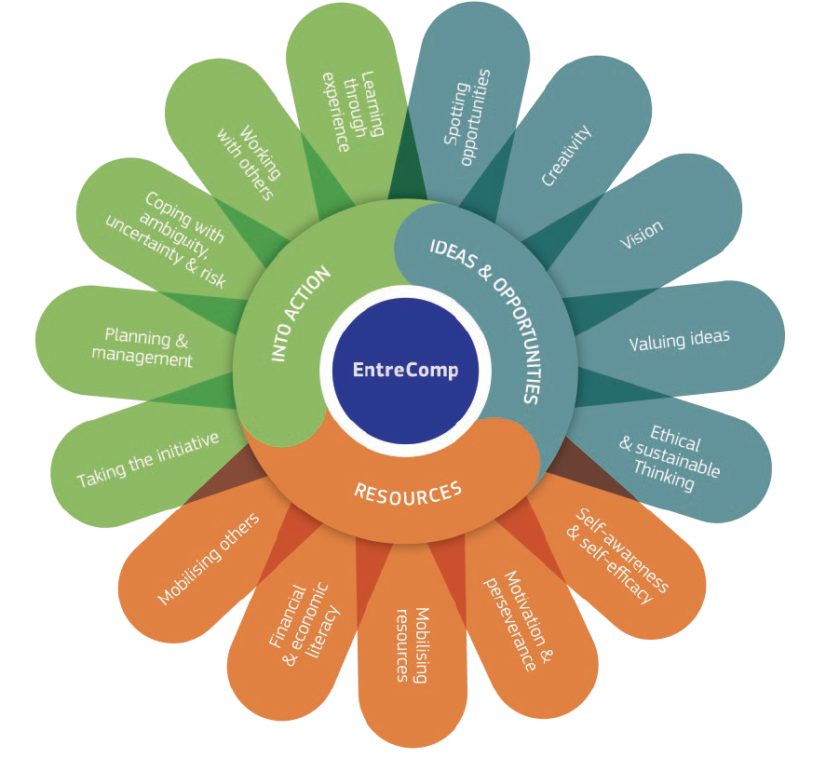
1.2 Creativity
1.2.A Creativity in EntreComp
This project has been funded with support from the European Commission. This document and its contents reflect the views only of the authors, and the Commission cannot be held responsible for any use which may be made of the information contained therein​
Legal description – Creative Commons licensing: The materials published on the EntreComp project website are classified as Open Educational Resources' (OER) and can be freely (without permission of their creators): downloaded, used, reused, copied, adapted, and shared by users, with information about the source of their origin.

Slide 2
Creativity for lifelong learning
According to the European Commission's Entrepreneurship Competence Framework known as 'EntreComp', creativity is one of the 15 skills that every student can develop to become an entrepreneur.
In EntreComp creativity is presented as one of the key competences in the area called 'Ideas and opportunities', although the creative process involves both the use of resources and the ability to act on ideas to shape and exploit their value.
This project has been funded with support from the European Commission. This document and its contents reflect the views only of the authors, and the Commission cannot be held responsible for any use which may be made of the information contained therein​
Legal description – Creative Commons licensing: The materials published on the EntreComp project website are classified as Open Educational Resources' (OER) and can be freely (without permission of their creators): downloaded, used, reused, copied, adapted, and shared by users, with information about the source of their origin.

Slide 3
Creativity for lifelong learning
This guide is intended to inspire more actors across Europe and beyond to get involved, to join a community of participants committed to embedding these competences for life into education, communities, work and enterprise
Source: The EntreComp conceptual model (Table1)
This project has been funded with support from the European Commission. This document and its contents reflect the views only of the authors, and the Commission cannot be held responsible for any use which may be made of the information contained therein​
Legal description – Creative Commons licensing: The materials published on the EntreComp project website are classified as Open Educational Resources' (OER) and can be freely (without permission of their creators): downloaded, used, reused, copied, adapted, and shared by users, with information about the source of their origin.

Slide 4
Creativity as a skill
Thanks to the Entrecomp Framework, Creativity is not considered as a rare gift given to lucky students or elected people but it is a competence that can be developed and trained by everyone.
Creativity is the ability to think to a task or a problem in a new or different way, or the ability to use imagination to generate new ideas. It is the ability to solve complex problems or find interesting ways to suggest new solutions.
Creativity=compentence for all=problemsolving tool for all
This project has been funded with support from the European Commission. This document and its contents reflect the views only of the authors, and the Commission cannot be held responsible for any use which may be made of the information contained therein​
Legal description – Creative Commons licensing: The materials published on the EntreComp project website are classified as Open Educational Resources' (OER) and can be freely (without permission of their creators): downloaded, used, reused, copied, adapted, and shared by users, with information about the source of their origin.

Slide 5
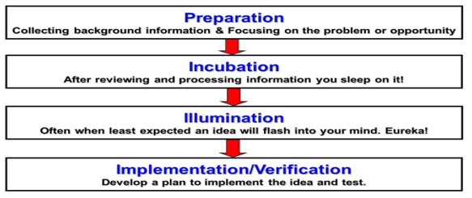
‘The art of thought’
The creative process includes the following four stages
Source: The art of thought, Graham Wallas
This project has been funded with support from the European Commission. This document and its contents reflect the views only of the authors, and the Commission cannot be held responsible for any use which may be made of the information contained therein​
Legal description – Creative Commons licensing: The materials published on the EntreComp project website are classified as Open Educational Resources' (OER) and can be freely (without permission of their creators): downloaded, used, reused, copied, adapted, and shared by users, with information about the source of their origin.

Slide 6
1.2 Creativity
1.2.B Stimulating Creativity
This project has been funded with support from the European Commission. This document and its contents reflect the views only of the authors, and the Commission cannot be held responsible for any use which may be made of the information contained therein​
Legal description – Creative Commons licensing: The materials published on the EntreComp project website are classified as Open Educational Resources' (OER) and can be freely (without permission of their creators): downloaded, used, reused, copied, adapted, and shared by users, with information about the source of their origin.

Slide 7
Exercises to stimulate your mind
4 preliminary considerations:
There are different types of actions that can be used to become more creative and develop lateral thinking
These exercises bring together ideas that serve very different needs or interests to form a new concept
These techniques can produce some silly results, but it’s ultimately a helpful way of getting your mind out of a creative rut
Participants will have to let their minds free to wander and create yet undiscovered ideas
This project has been funded with support from the European Commission. This document and its contents reflect the views only of the authors, and the Commission cannot be held responsible for any use which may be made of the information contained therein​
Legal description – Creative Commons licensing: The materials published on the EntreComp project website are classified as Open Educational Resources' (OER) and can be freely (without permission of their creators): downloaded, used, reused, copied, adapted, and shared by users, with information about the source of their origin.

Slide 8
Paraphrasing questions, pt.1
Imagine you have to answer this very simple question: “How much is 5+5?”. Of course there is only one unique correct answer: 10!
What if you were asked the same question in a different way such as: “What numbers give 10 as sum?” – How many answers would there be now? Infinite numbers, as well as infinite ways to get to the same answer.
This project has been funded with support from the European Commission. This document and its contents reflect the views only of the authors, and the Commission cannot be held responsible for any use which may be made of the information contained therein​
Source: VCD Germany
Legal description – Creative Commons licensing: The materials published on the EntreComp project website are classified as Open Educational Resources' (OER) and can be freely (without permission of their creators): downloaded, used, reused, copied, adapted, and shared by users, with information about the source of their origin.

Slide 9
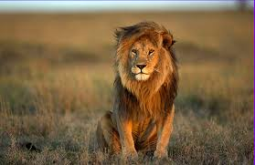
Paraphrasing questions, pt.2
Imagine you have ‘lion’ as answers and think to three different questions.
e.g. Which animal is the king of the jungle?
This project has been funded with support from the European Commission. This document and its contents reflect the views only of the authors, and the Commission cannot be held responsible for any use which may be made of the information contained therein​
Legal description – Creative Commons licensing: The materials published on the EntreComp project website are classified as Open Educational Resources' (OER) and can be freely (without permission of their creators): downloaded, used, reused, copied, adapted, and shared by users, with information about the source of their origin.

Slide 10
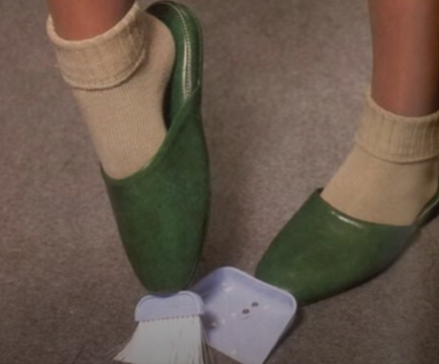
Connecting and combining
Chindogu is know as the Japanese art of creating essentially useless inventions that could be used to solve basic everyday problems, but do so in a ridiculous way (i.e. Connecting and combining seemingly opposite ideas).
This project has been funded with support from the European Commission. This document and its contents reflect the views only of the authors, and the Commission cannot be held responsible for any use which may be made of the information contained therein​
Legal description – Creative Commons licensing: The materials published on the EntreComp project website are classified as Open Educational Resources' (OER) and can be freely (without permission of their creators): downloaded, used, reused, copied, adapted, and shared by users, with information about the source of their origin.

Slide 11
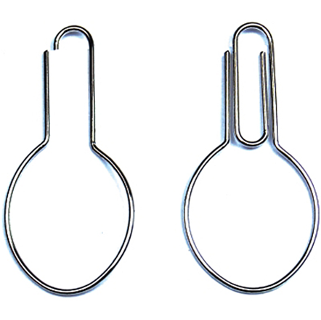
Syneptic exercises
They refers to the ability of being able to find connections and relationships between concepts, objects and ideas that apparently have no connection.
For example:
What can I do with a paper clip and a spoon?
What similarities could exist between the Limpopo River in Africa and Lake Baikal in Siberia?
This project has been funded with support from the European Commission. This document and its contents reflect the views only of the authors, and the Commission cannot be held responsible for any use which may be made of the information contained therein​
Legal description – Creative Commons licensing: The materials published on the EntreComp project website are classified as Open Educational Resources' (OER) and can be freely (without permission of their creators): downloaded, used, reused, copied, adapted, and shared by users, with information about the source of their origin.

Slide 12
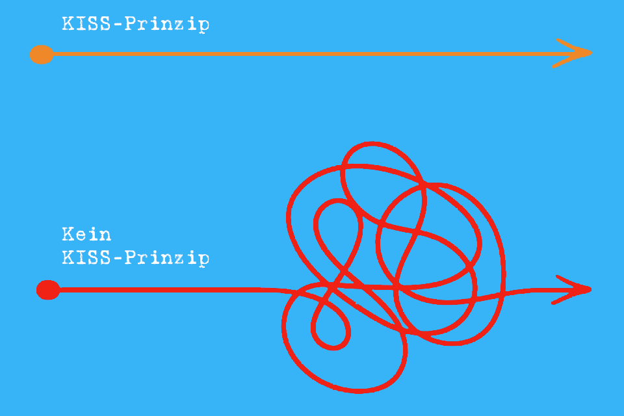
The K.I.S.S. principle
The “Keep It Simple, Stupid!” principle in a snapshot:
What is KISS
What is NOT KISS
Source: t2informatik GmbH, Berlin
This project has been funded with support from the European Commission. This document and its contents reflect the views only of the authors, and the Commission cannot be held responsible for any use which may be made of the information contained therein​
Legal description – Creative Commons licensing: The materials published on the EntreComp project website are classified as Open Educational Resources' (OER) and can be freely (without permission of their creators): downloaded, used, reused, copied, adapted, and shared by users, with information about the source of their origin.

Slide 13
Defining the principle
The Keep It Short and Simple (or stupid) principle is a design rule stating that systems work better when they have simple rather than complex designs. The KISS is not intended to imply stupidity.
Quite the opposite, it is usually associated with intelligent systems that can be misinterpreted as stupid because of their simplicity.
This project has been funded with support from the European Commission. This document and its contents reflect the views only of the authors, and the Commission cannot be held responsible for any use which may be made of the information contained therein​
Legal description – Creative Commons licensing: The materials published on the EntreComp project website are classified as Open Educational Resources' (OER) and can be freely (without permission of their creators): downloaded, used, reused, copied, adapted, and shared by users, with information about the source of their origin.

Slide 14
Intùiti Cards
It's a tool for creative thinking based on visual and imaginary associations, so you just have to shuffle the deck, pick a card, and read the fairy tale…and suggest the end of the story.
Each card represents a powerful incentive, is designed using Gestalt principles and offers an evocative fairy tale which doesn’t have a written ending.
Learn more about Intùiti
This project has been funded with support from the European Commission. This document and its contents reflect the views only of the authors, and the Commission cannot be held responsible for any use which may be made of the information contained therein​
Legal description – Creative Commons licensing: The materials published on the EntreComp project website are classified as Open Educational Resources' (OER) and can be freely (without permission of their creators): downloaded, used, reused, copied, adapted, and shared by users, with information about the source of their origin.

Slide 15
Two important reminders
Don’t fall in love with your ideas:
The perfect idea is just an illusion that hinder the process of our creative thinking. The challenge is not generating ideas but the ability to select the best ideas. Having lots of ideas is good if we are able to discard them.
Do something different every day
Doing and creating something new can rekindle life and liveliness allowing us to enrich and evolve. Creating something new in our lives every day is a very simple action. We can start changing chairs, choose a food we have never tasted but also create something with our hands because manual activity helps the mind to the gap between thoughts and reality.
This project has been funded with support from the European Commission. This document and its contents reflect the views only of the authors, and the Commission cannot be held responsible for any use which may be made of the information contained therein​
Legal description – Creative Commons licensing: The materials published on the EntreComp project website are classified as Open Educational Resources' (OER) and can be freely (without permission of their creators): downloaded, used, reused, copied, adapted, and shared by users, with information about the source of their origin.

Slide 16
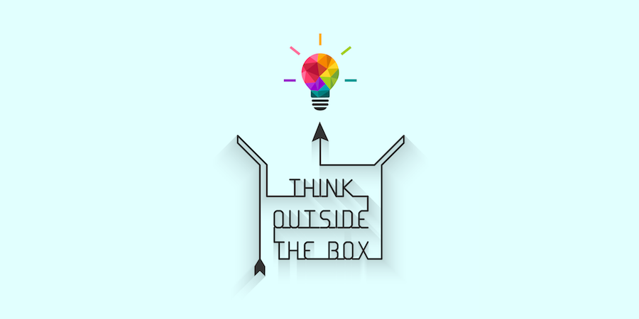
Takeaways and conclusions
People often want to find the solution to their problems using creativity as it was a immediate tool or method. But using a given ‘recipe’ is not the right path, you have to work and develop your lateral thinking, your critical aptitude and also the courage to….
This project has been funded with support from the European Commission. This document and its contents reflect the views only of the authors, and the Commission cannot be held responsible for any use which may be made of the information contained therein​
Legal description – Creative Commons licensing: The materials published on the EntreComp project website are classified as Open Educational Resources' (OER) and can be freely (without permission of their creators): downloaded, used, reused, copied, adapted, and shared by users, with information about the source of their origin.

